Slide 1
Gamified App For Students:
Meet & Merit
Iteration 1 Review & Project Proposal
Name: Shuai Jiang (Jeffrey)
Student Number: C00292846
Date: 20th October 2025

Slide 2
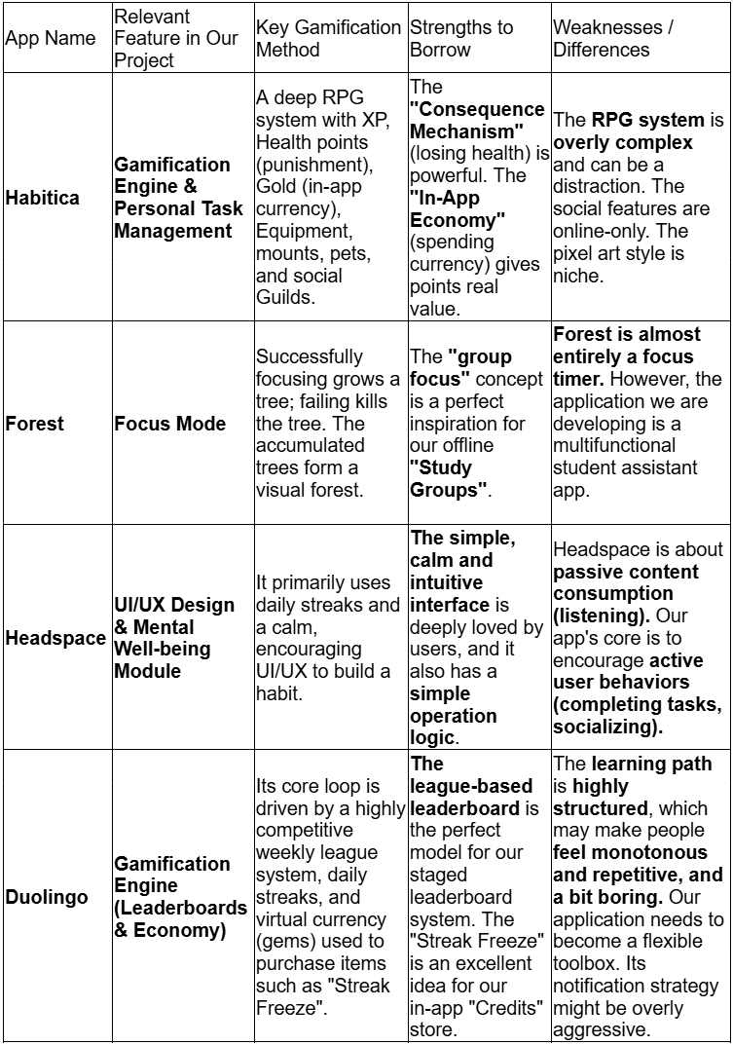
The Challenge & The Gap
Existing apps lack student focus & offline social features.
Student Challenges:
Market Opportunity:
Higher education students often struggle with disorganized tasks from various sources.
Difficulty in maintaining motivation for self-directed study is common.
Many experience a sense of social isolation on large campuses.
Balancing academic pressures with personal well-being is a constant challenge.
Analysis of apps like Habitica, Forest, Headspace, and Duolingo reveals a market gap .
Existing apps often lack a specific focus on the student ecosystem.
There's a unique opportunity for an app specifically for students that encourages offline social interaction .

Slide 3
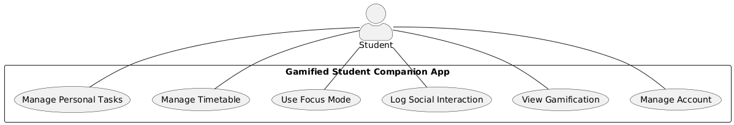
Solution: A Gamified Companion App
This project is a mobile app designed to help students manage their studies and personal growth in a more engaging way.
It uses game-like features (Points, Badges, Leaderboards) to motivate students .
Its unique focus is to reward real-world actions, especially providing a tool to practice and improve face-to-face social skills .

Slide 4
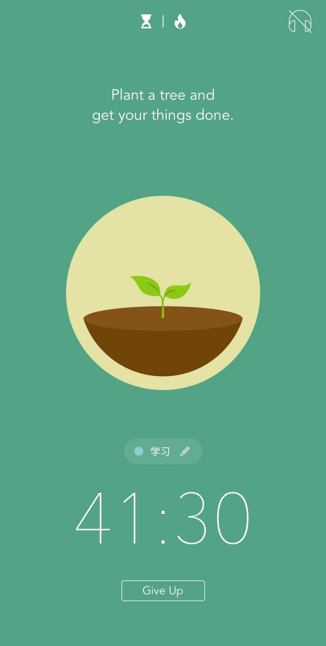
Focus Mode (with Consequences):
A timer to help users study without phone distraction .
Inspired by apps like Forest, successfully completing a session earns points, but failing (using the phone) results in a small point penalty . This consequence mechanism aims to make the commitment stronger.

Slide 5
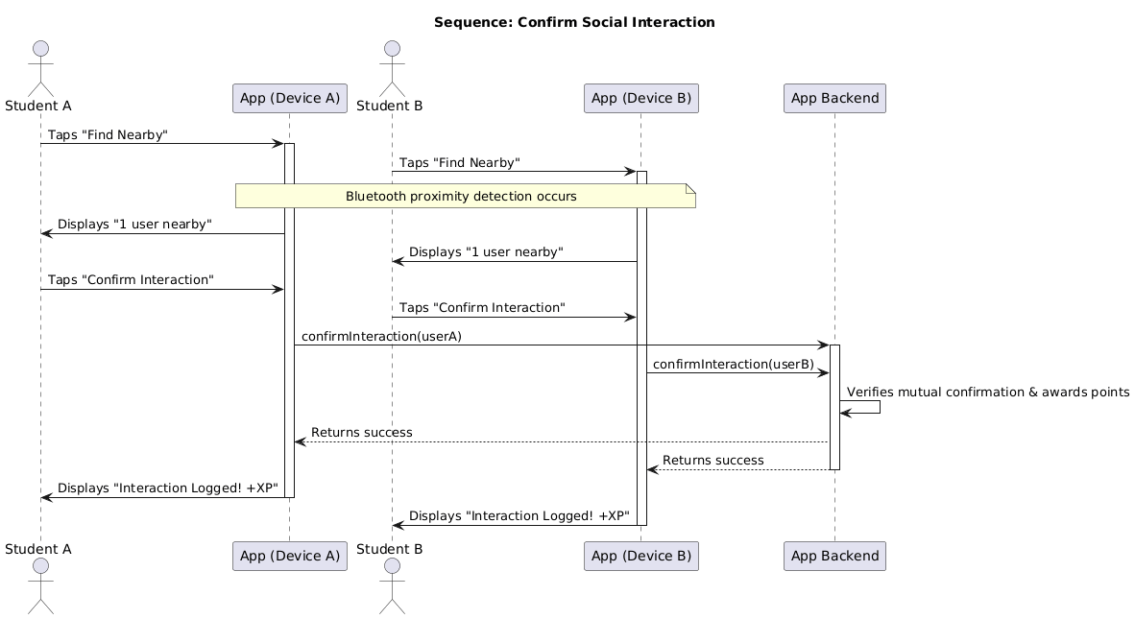
Offline Social Interaction (Bluetooth-based):
The app's key differentiator: rewarding real-world, face-to-face interactions .
Uses Bluetooth for proximity detection; students mutually confirm an interaction to earn points .
Includes rules (cooldown, daily cap) to prevent abuse and is anonymous & opt-in to protect privacy.

Slide 6
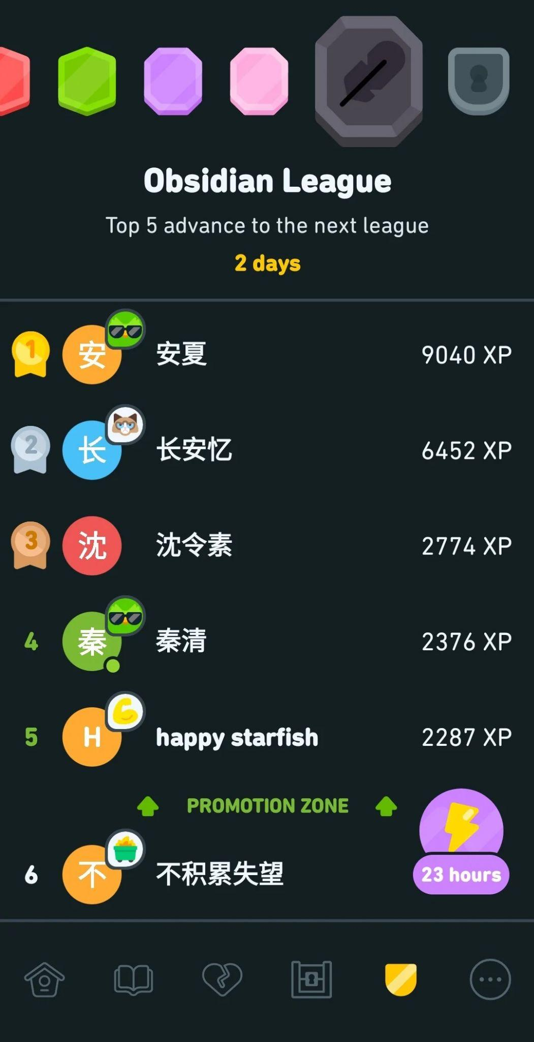
League-based Leaderboard:
Instead of one global ranking, uses a staged system inspired by Duolingo .
Users compete in small, weekly leagues with clear promotion/demotion zones .
Keeps competition fair and motivating for everyone, regardless of their overall rank.

Slide 7
A Modern & Flexible Architecture
Architecture
Backend: Python & Django
Decoupled (Client-Server) chosen for flexibility and scalability (allows future iOS/Web clients).
selected for faster development using built-in features (User Auth, Admin) .
Frontend
Hosting Plan
Native Android App using Kotlin chosen to ensure the best quality & performance on one platform.
Intend to use a PaaS like Heroku for easy and low-risk deployment for demonstration.

Slide 8
Iteration 1 Complete & Plan for Iteration 2
Iteration 1 Achievements (Completed for Oct 20th):
In-depth Research Document (First Draft) analyzing market and technology.
Detailed Functional Specification (First Draft) outlining core features and use cases.
Initial Project Setup and documentation established on GitHub.
Presentation Slides prepared.
Plan for Iteration 2 (Target: Dec 1st):
Develop a working Alpha version of the Android application, focusing on implementing core functionalities like User Registration/Login and the Personal To-Do List.
Prepare a Screencast to demonstrate the working Alpha version.
Refine and finalize both the Research Document and Functional Specification based on feedback.

Slide 9
THANK YOU

